Slide 1
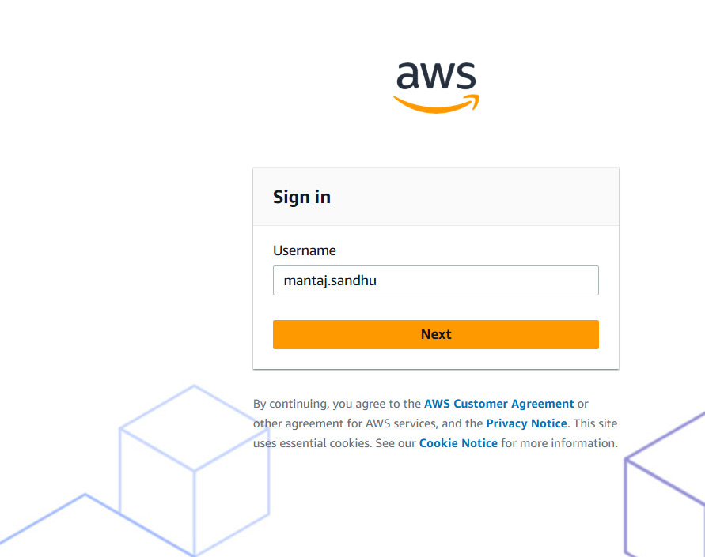
Log in to your AWS Portal.
With your Credentials

Slide 2
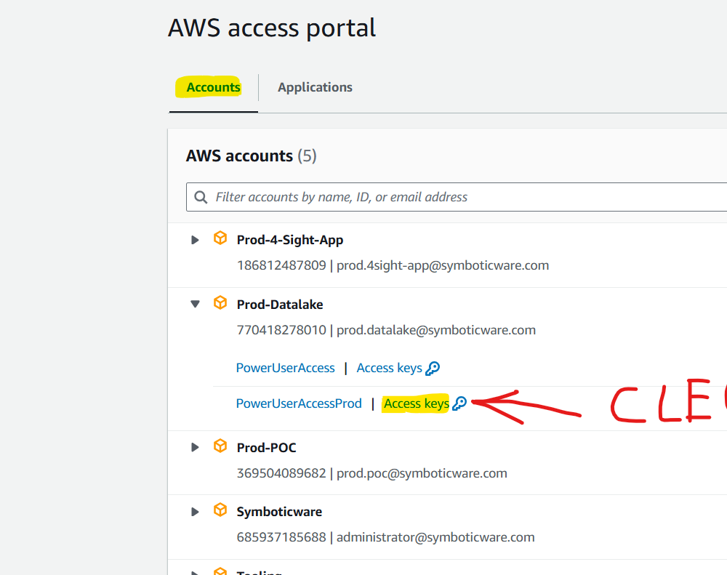
Click on "Account," and then select "Prod-Datalake."
In Prod-Datalake, click on the Access keys in front of PowerUserAccessProd

Slide 3
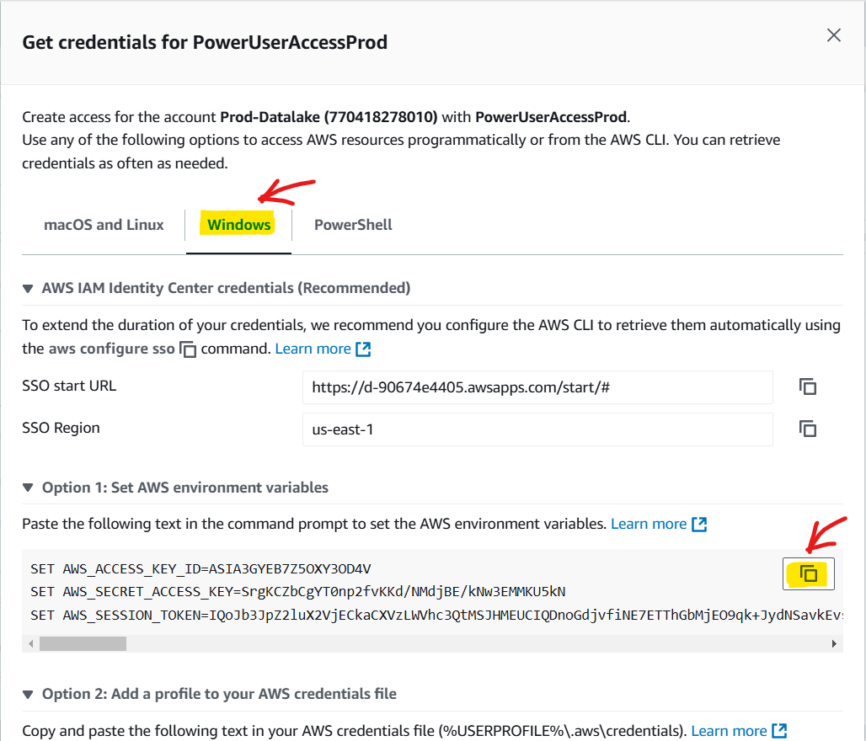
Select "Windows" and then copy all three commands from Option 1.

Slide 4
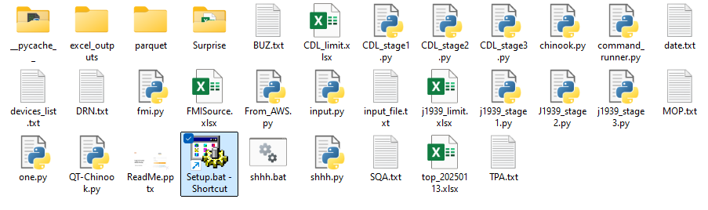
Download, unzip and open The Chinook Folder From GET-HUB https://github.com/Mantaj-Singh-Sandhu/Chinook-2.0.git or Download Chinook 2.0.7z

Slide 5
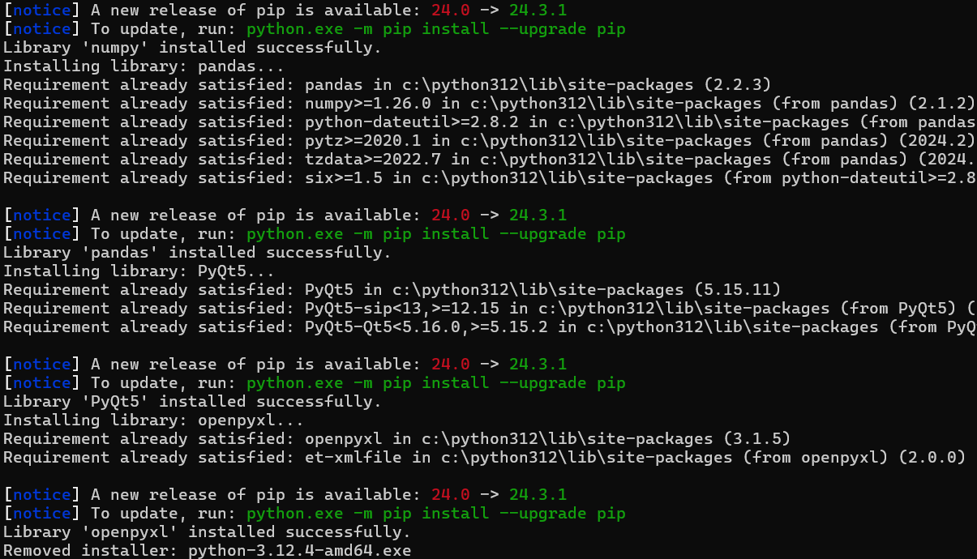
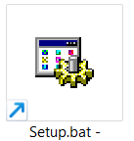
For First time, install the Libraries using the setup

Slide 6
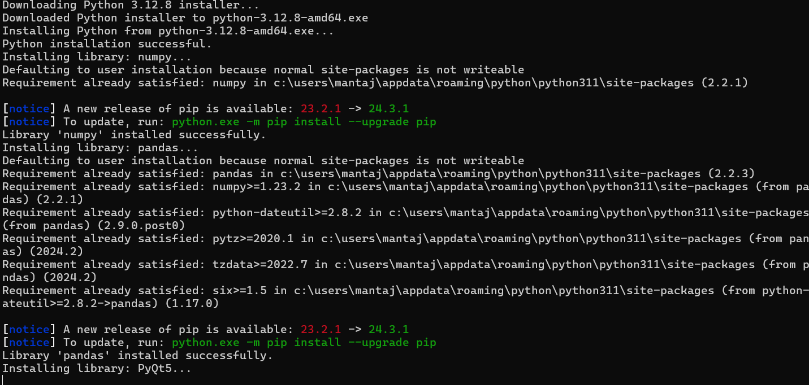
Note: Setup is a one-time step, No need to do this step every time you use Chinook It will take Some minutes to install. CMD will Auto Close After Installation

Slide 7
Click on the folder location, erase all text like “C:\Users\Mantaj\Documents\Chinook , type CMD, and press Enter. The terminal will open with the prompt for Folder Location.
CMD

Slide 8
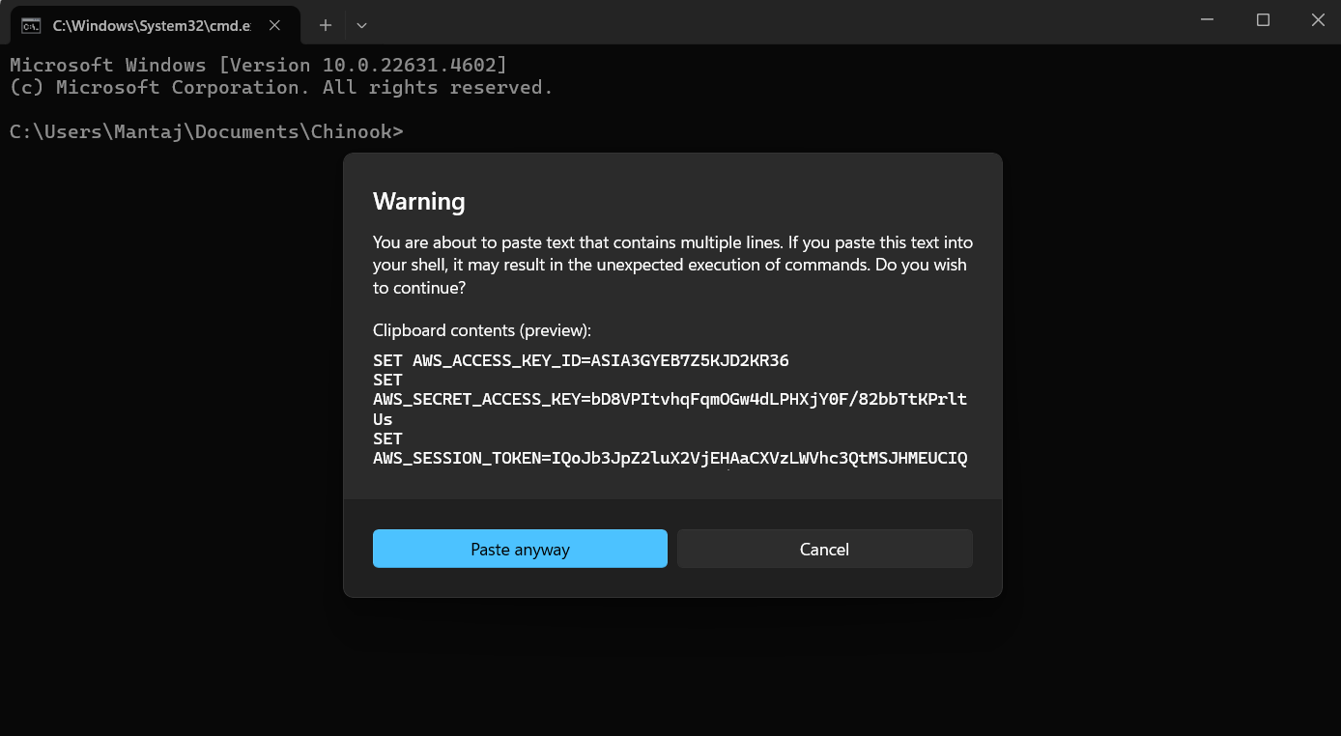
In the CMD past the Three Commands from the AWS

Slide 9
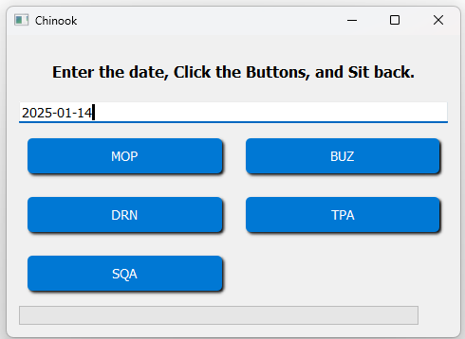
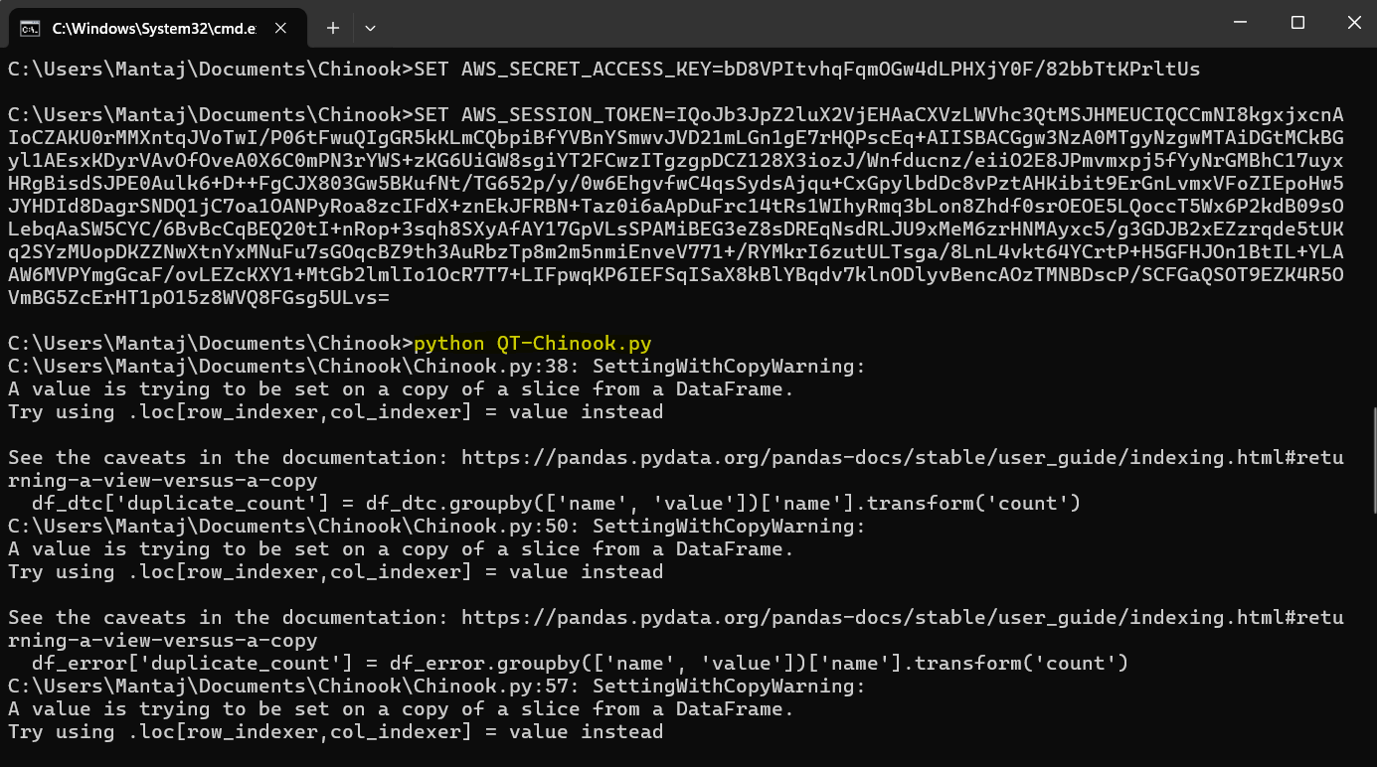
This Session is ready to fetch data from the AWS Now type. python QT-Chinook.py and Press Enter set the date, and click on one of the clients

Slide 10
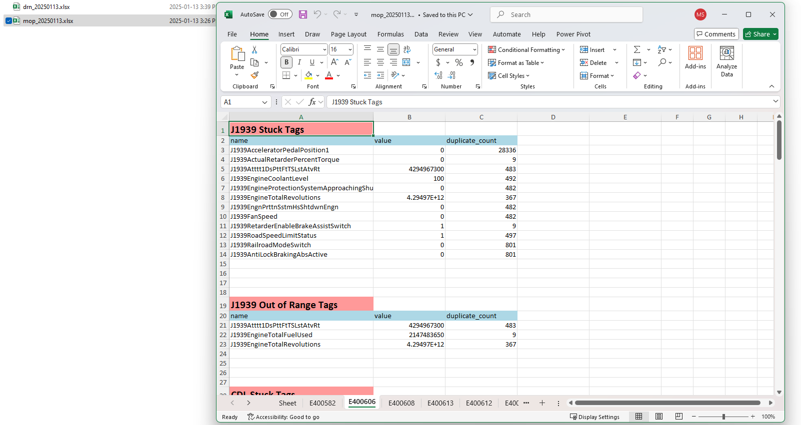
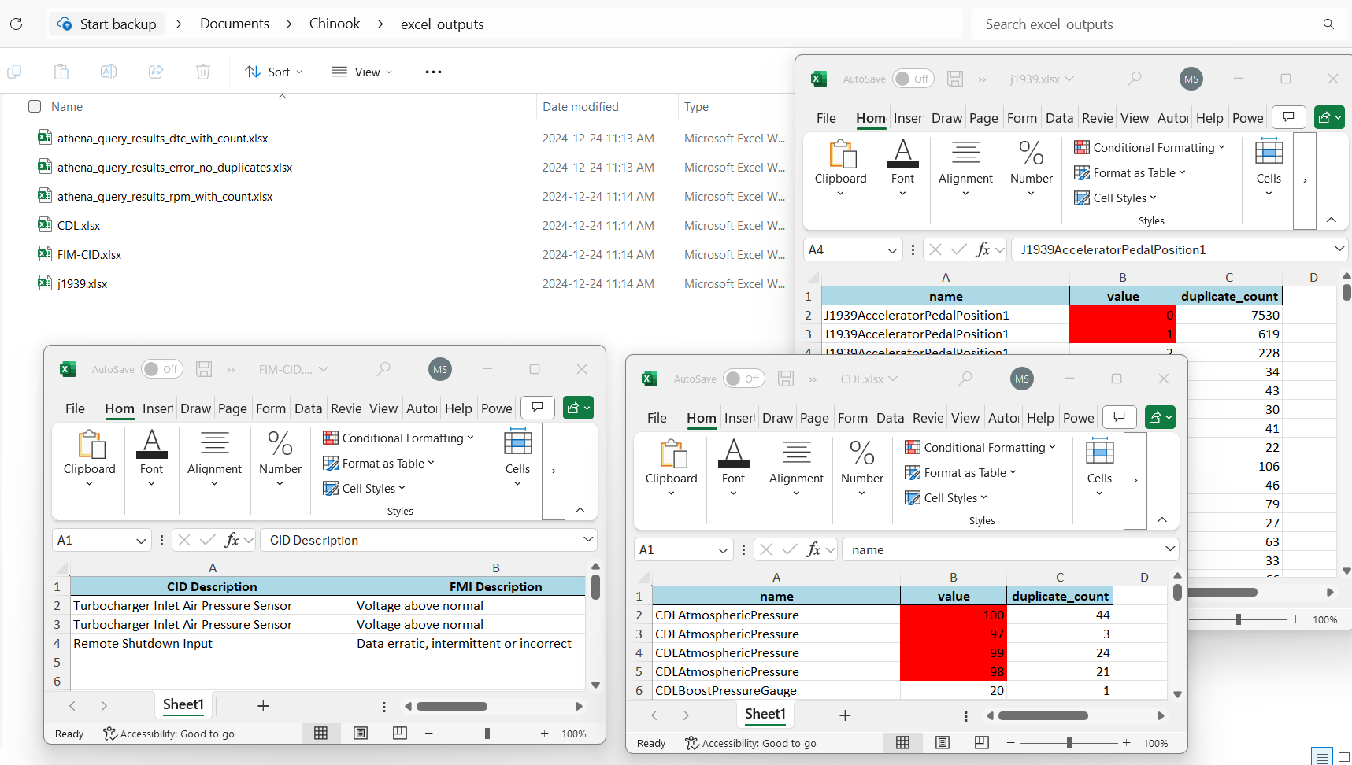
Report File Ready in Surprise Folder

